Slide 1


Slide 2
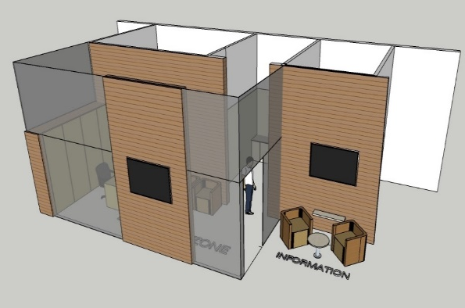
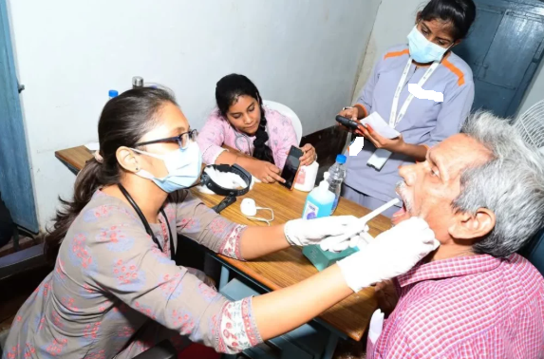
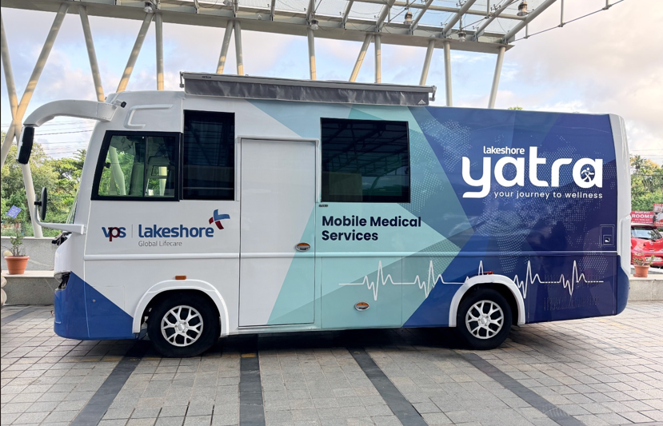
The journey begins today…
1
2
3
Yatra Pod
Yatra Camp
Yatra MMU
Fixed healthcare facility — diagnostics, consultations & wellness under one roof
Organised community health camps — screenings, awareness & preventive care
Mobile Medical Unit — bringing quality healthcare to remote & underserved areas

